Slide 1
What is a data type
A data type is a collection of objects and operations that act on these.

Slide 2
Abstraction
The essence of abstractions is preserving information that is relevant in a given context, and forgetting information that is irrelevant in that context.
– John V. Guttag
Abstraction means displaying only essential information and hiding the other details. Data abstraction refers to providing only essential information about the data to the outside world, hiding the background details or implementation. Consider a real life example of a man driving a car. The man only knows that pressing the accelerators will increase the speed of car or applying brakes will stop the car but he does not know about how on pressing accelerator the speed is actually increasing, he does not know about the inner mechanism of the car or the implementation of accelerator, brakes etc in the car. This is what abstraction is.

Slide 3
Abstract Data Type
Is a data type that is organized in such a way that the specification of the objects and specification of the operations on the object is separated from the representation of the objects and implementation of the operations.(Logical/Mathematical view of DS)
Also classification of operations
Creators
Transformers
Reporters/observers

Slide 4
List as ADT
Objects : A countable number of ordered homogeneous values.
Operations: create()- returns a list of size n
get() – Return an element from the list at any given position. insert() – Insert an element at any position of the list. remove() – Remove the first occurrence of any element from a non-empty list. removeAt() – Remove the element at a specified location from a non-empty list. replace() – Replace an element at any position by another element. size() – Return the number of elements in the list. isEmpty() – Return true if the list is empty, otherwise return false. isFull() – Return true if the list is full, otherwise return false.

Slide 5
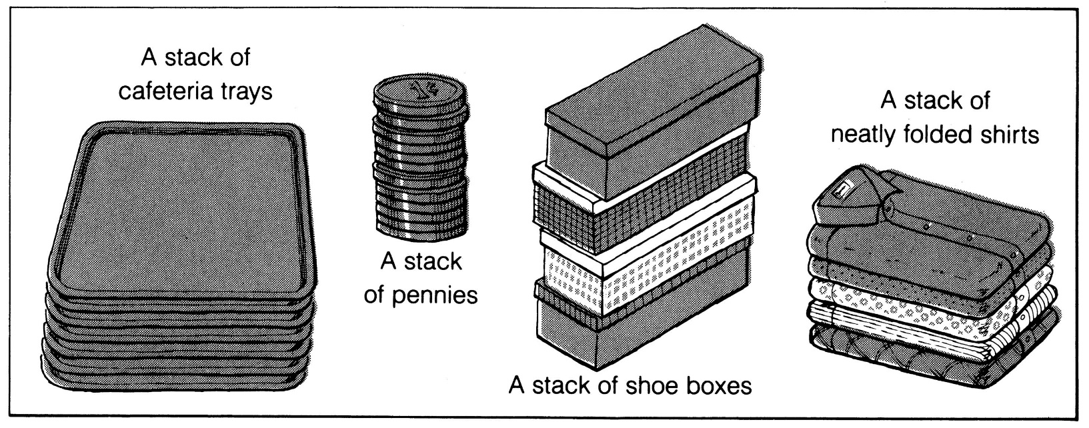
What is a stack?
It is an ordered group of homogeneous items of elements.
Elements are added to and removed from the top of the stack (the most recently added items are at the top of the stack).
The last element to be added is the first to be removed (LIFO: Last In, First Out).

Slide 6
Stack as ADT
A Stack contains elements of same type arranged in sequential order. All operations takes place at a single end that is top of the stack and following operations can be performed: push() – Insert an element at one end of the stack called top. pop() – Remove and return the element at the top of the stack, if it is not empty. peek() – Return the element at the top of the stack without removing it, if the stack is not empty. size() – Return the number of elements in the stack. isEmpty() – Return true if the stack is empty, otherwise return false. isFull() – Return true if the stack is full, otherwise return false.

Slide 7
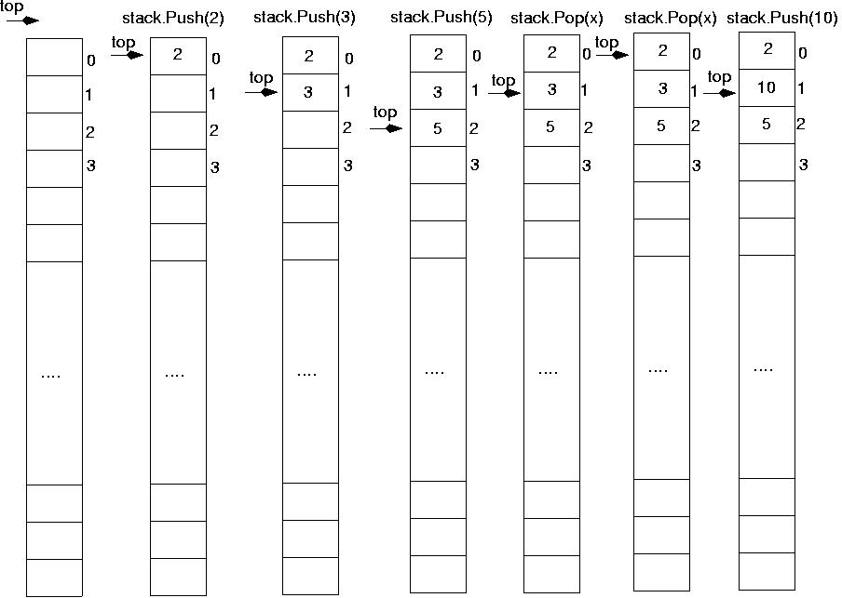

Slide 8
Implementation using Array
#include<iostream>
using namespace std;
typedef int elt_type;
class stack
{ int top;
elt_type a[10];
int max;
public:elt_type peek(){ return a[top];}
stack(int m);
bool IsFull();
bool IsEmpty();
void push(elt_type x);
elt_type pop();
void display();
int size(){return top+1;}
};

Slide 9
stack::stack(int m)
{
max=m;
top=-1;
}
bool stack::IsFull()
{
if(top==max-1)
return true;
return false;
}
bool stack::IsEmpty()
{ if(top==-1)
return true;
return false;
}

Slide 10
void stack::push(elt_type item)
{ if(IsFull())
cout<<"Stack is full \n";
else
a[++top]=item;
}
elt_type stack::pop()
{
if(IsEmpty())
{cout<<"stack is empty\n"; return -1;}
else{
cout<<"deleted element is"<<(a[top]);
return (a[top--]);
}
void stack::display()
{ if(IsEmpty())
cout<<"stack is empty\n";
else
for(int i=top;i>-1;i--)
cout<<a[i];
}

Slide 11
int main()
{ stack s(10);
int option,ele;
char ch;
do{
cout<<"1.push\n2.Pop\n3.display\n4.exit\n";
cin>>option;
switch(option)
{
case 1: cout<<"enter the element to be pushed\n";
cin>>ele;
s.push(ele);
break;
case 2: cout<<s.pop();
break;
case 3: s.display();break;
case 4: return 0;
}
cout<<"Do u want to continue?\n";
cin>>ch;
}while((ch=='y')||(ch=='Y'));
return 0;}

Slide 12
Simple Stack Applications
Checking parenthesis in an expression
Checking for palindrome
Converting number to base n
Reversing a number

Slide 13
Algorithm for checking expression
Scan the expression from left to right.
Whenever a scope opener( ‘(‘,’{‘,’[‘ ) is encountered while scanning the expression, it is pushed to stack.
Whenever as scope ender( ‘)’, ‘}’, ‘]’) is encountered, the stack is examined. If stack is empty, scope ender does not have a matching opener and hence string is invalid. If stack is non empty, we pop the stack and check whether the popped item corresponds to scope ender. If a match occurs, we continue. If it does not, the string is invalid.
4. When the end of string is reached, the stack must be empty; otherwise 1 or more scopes have been opened which have not been closed and string is invalid.

Slide 14
Ex1:(a+b) * (c+d
Ex2:(a+b)*c+d)
(
(
(
(
(a+b)
Pop ‘(‘ since there is ‘)’ & continue
(a+b) *(
Push ‘(‘
(a+b) *(c+d
End of string reached but stack not empty. Hence invalid
push ‘(‘
(
(
push ‘(‘
(a+b)
pop‘(‘ and continue
(a+b)*c+d)
Stack empty when ‘)’ encountered.hence invalid

Slide 15
Ex3: (a+b)*({c*d)
(
(
(
push ‘(‘
(a+b)
pop‘(‘ and continue
(a+b)*(
push‘(‘ and continue
{
{
(
(
(a+b)*({
push ‘{ and continue‘
(a+b)*({c*d)
No match between closing scope ‘)’ and opening scope ‘{‘. Hence invalid.

Slide 16
Ex4: (a+{b*c}+(c*d))
{
(
(
(
(
push ‘(‘ and continue
(a+{
push‘{‘ and continue
(a+{b*c}
pop‘{‘ and continue
(
(
(
(a+{b*c}+(
push ‘( and continue‘
(a+{b*c}+(c*d)
Pop ‘(‘
(a+{b*c}+(c*d))
Pop ‘(‘.
End of string and stack empty. Hence valid

Slide 17
Checking for palindrome
Algorithm
Scan the string from left to right till the end and push every char you encounter during the scan to the stack.
Rescan the string left to right till end and do the following for every char you encounter during scan. Pop one char and compare current char with the popped one.If no match report immediately non palindrome other wise proceed to the next char.

Slide 18
Multiple Stack implementation in single array

